Slide 1

Rule-Based Systems
Adaptive Logical Deduction

Slide 2

Rule-Based Systems
Rule-Based Systems use logical deduction to derive new facts from existing knowledge.
Rule-Base Systems require a knowledge base which holds information about the universe of the agent.
The knowledge base includes:
Known Facts
Rules for Deriving New Facts (AND-based)
We’ll look at three types of Rule-Based Logics:
Propositional Logic
First-Order Logic
Fuzzy Logic
Techniques:
Forward Chaining (Facts->Rule->Conclusion)
Backward Chaining (Conclusion->Rule->Facts)

Slide 3

Propositional Logic
In propositional logic, simple statements (constant identifiers, or propositions) are combined with rules (made of logical operators) to derive new facts.
Benefits
Simple
Fast
Drawbacks
Inflexible - no properties of objects or relations
Every rule must be explicitly entered; no classes of objects
Rules
If SUNNY, then GOOD_WEATHER.
If RAINY, then BAD_WEATHER.
If BOB_HAS_SHOES and GOOD_WEATHER, then BOB_SHOULD_GO_OUTSIDE
If !BOB_HAS_SHOES and BAD_WEATHER, then BOB_SHOULD_GO_OUTSIDE
Added Fact
SUNNY, BOB_HAS_SHOES
New Fact
GOOD_WEATHER, BOB_SHOULD_GO_OUTSIDE

Slide 4

Example – Agent Banter
Games can play spoken banter between agents and/or players by using propositional logic[1]. (See http://www.valvesoftware.com/publications/2012/GDC2012_Ruskin_Elan_DynamicDialog.pdf for an example.)
Rules
If SNAKE_PRESENT, then PLAY(“I hate snakes!”)
If SNAKE_PRESENT and SNAKE_ASP, then PLAY(“Asps…very dangerous. You go first.”)
If SNAKE_PRESENT and LEVEL_PLANE, then PLAY(“I have had it with these monkey-fighting snakes on this Monday through Friday plane!”)
Added Facts
SNAKE_PRESENT, SNAKE_ASP
New Fact
PLAY(“Asps…very dangerous. You go first.”)
Snakes…Why’d it have to be snakes?

Slide 5
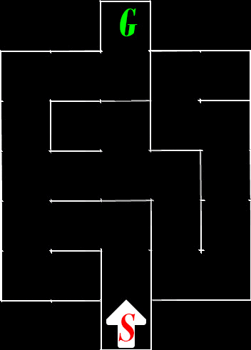
Example - Maze Solver
Most simple mazes can be solved by following either the right or left wall.
We can define rules for how to traverse the maze based on which walls are present in the current cell.
For each cell we traverse, we will add facts to our system based on which walls are present in the cell.
Rules
If !LEFT_WALL, then SHOULD_TURN_LEFT.
If LEFT_WALL and !FORWARD_WALL, then SHOULD_MOVE_FORWARD.
If LEFT_WALL and FORWARD_WALL, then SHOULD_TURN_RIGHT.

Slide 6

First-Order Logic
(Predicate Logic)
In predicate logic, statements made up of predicates & identifiers are combined with simple rules to derive new facts.
Benefits
Flexible
Implicit (variable-based) rules
Drawbacks
Slower
Uses more resources
Rules
If Animal(X) and Barks(X), then Dog(X).
If Mammal(X), then Animal(X).
Added Facts
Mammal(fido), Barks(fido).
New Facts
Animal(fido), Dog(fido).

Slide 7
Fuzzy Logic
In fuzzy logic, statements have a degree of truth [0,1].
Benefits
Very Flexible
Implicit Truth Degree Calculation
Gives impression of randomness.
Drawbacks
Slower yet
Uses yet more resources
Facts
Tall(Bob) = 0.7
Medium(Bob) = 0.3
Short(Bob) = 0.0
1
Facts
Tall(Ted) = 0.0
Medium(Ted) = 0.4
Short(Ted) = 0.6
Short
Tall
Medium
Truth
0.5
0
Height

Slide 8
Fuzzy Logic Operators
We can use “AND”, “OR” and “NEGATE” operators in our rules with Fuzzy Logic, but they will act differently than when used with Boolean properties.
For AND, we will take the minimum result of the predicates.
For OR, we will break the rule into multiple rules, without ORs.
For NEGATE, we take 1.0 minus the predicate value.
Facts
Health(bob) = .7
Shields(bob) = .1
Ammo(bob) = .5
Rules
H(X) & S(X) & A(X) -> Attack(X)
H(X) & !S(X) & A(X) -> Defend(X)
!H(X) & !S(X) | !H(X) & !A(X) -> Esc(X)
New Rules
!H(X) & !S(X) -> Esc(X)
!H(X) & !A(X) -> Esc(X)
New Facts
Min(.7, .1, .5) = .1 [Attack(bob)]
Min(.7, .9, .5) = .5 [Defend(bob)]
Min(.3, .9) = .3 [Esc(bob)]
Min(.3, .5) = .3 [Esc(bob)]

